Slide 1
MODULE 2
P R O C E S S F R A M E W O R K

Slide 2
I N T R O D U C T I O N
Process framework establishes the foundation for a complete software process
It identifies a small no: of framework activities that are applicable to all software projects
It encompasses a set of umbrella activities, that are applicable to entire s/w process

Slide 3
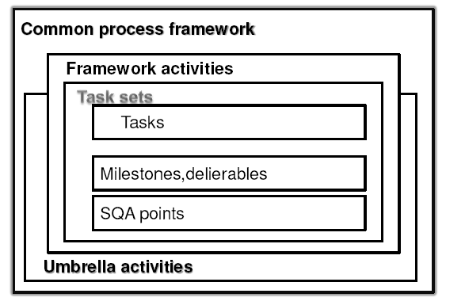
S O F T W A R E P R O C E S S F R A M E W O R K

Slide 4
U M B R E L L A A C T I V I T I E S
Umbrella activities
It encompasses a set of framework activities
Framework activities
Each framework activity consist of a set of software engineering actions
Software engineering action:
It is a collection of related tasks set that produces a major s/w engineering work product
Eg: Design, Requirement gathering
Each engineering action is populated with individual work tasks

Slide 5
Task set
It defines the actual work to be done to accomplish the objectives of software engineering action
It is a collection of
Software engineering work tasks
Related work products
Quality assurance points
Project milestones

Slide 6
E X A M P L E
Eg: If Requirement gathering is a software engineering action, then task set of requirement gathering is
Make a list of stakeholders of project
Invite stakeholders to an informal meeting
Ask each stakeholders to make a list of features & functions required
Discuss requirements and build final list
Prioritize requirements
Note the areas of uncertainty

Slide 7
G E N E R I C P R O C E S S F R A M E W O R K A C T I V I T I E S
These activities are applicable to majority of software projects
Can be used during development of small pgms, large web applications, complex computer based s/m
Details of s/w process will be different but the framework activities remains the same
[A] . Communication
[B] . Planning
[C] . Modeling
[D] .Construction
[E] .Deployment

Slide 8
[A]. C O M M U N I C A T I O N
This activity involves heavy communication & collaboration with customer & other stakeholders
Encompasses requirement gathering & other related activities

Slide 9
[B]. P L A N N I N G
This activity establishes a plan for the software engineering work
It describes
Technical tasks to be conducted
The risks that are likely to happen
Resources required
Work product to be produced
Work schedule

Slide 10
[C]. M O D E L I N G
This activity encompasses the creation of models
It allows the developer & customer to understand the software requirements & design
It is composed of 2 software engineering actions
Analysis
Design

Slide 11
M O D E L I N G
Analysis
It consists of set of work tasks that lead to the creation of analysis model or requirement specification
Set of tasks include
Requirement gathering
Elaboration
Negotiation
Specification
Validation

Slide 12
M O D E L I N G
Design
Encompasses work tasks that create a design model
Tasks are:
Data design
Architectural design
Interface design
Component level design

Slide 13
C O N S T R U C T I O N
This activity combines the code generation & testing, which is required to uncover the errors in the code

Slide 14
D E P L O Y M E N T
Software is delivered to the customer who evaluates the delivered product
Provides feedback based on the evaluation

Slide 15
G E N E R I C U M B R E L L A A C T I V I T I E S
Software project tracking & control
Risk management
Software quality assurance
Formal technical reviews
Measurement
Software configuration management
Reusability management
Work product preparation & production

Slide 16
S O F T W A R E P R O J E C T T R A C K I N G & C O N T R O L
Allows the software team to assess progress of the project, against project plan
Take necessary action to maintain schedule

Slide 17
R I S K M A N A G E M E N T
Assess the risks that may affect the outcome or the quality of the project

Slide 18
S O F T W A R E Q U A L I T Y A S S U R A N C E
Defines & conducts the activities required to ensure software quality

Slide 19
F O R M A L T E C H N I C A L R E V I E W S
Assess software engineering work products to uncover & remove errors, before they are propagated to next action or activity

Slide 20
M E A S U R E M E N T
This activity defines & collects
Process
Project and
Product measures
That assist the team in delivering software, that meets customers needs

Slide 21
S O F T W A R E C O N F I G U R A T I O N M A N A G E M E N T
Manages the effects of change throughout the software process

Slide 22
R E U S A B I L I T Y M A N A G E M E N T
Defines criteria for work product reuse
Establish mechanisms to achieve reusable components

Slide 23
W O R K P R O D U C T P R E P A R A T I O N & P R O D U C T I O N
Encompasses the activities required to create work products such as
Models
Documents
Logs
Forms
Lists

Slide 24
CMM (Capability Maturity Model

Slide 25
Also called as SEI-CMM
Developed by the Software Engineering Institute (SEI) of the Carnegie Mellon University.
Framework that describes the key elements of an effective software process.

Slide 26
It is a strategy for improving the software process, irrespective of the actual life cycle model used.
Used to judge the maturity of the s/w processes of an organization and to identify the key practices that are required to increase the maturity of these processes.

Slide 27
The five levels of software process maturity
Maturity level indicates level of process capability:
Initial (Maturity Level 1)
Repeatable (Maturity Level 2)
Defined (Maturity Level 3)
Managed (Maturity Level 4)
Optimizing (Maturity Level 5)

Slide 28
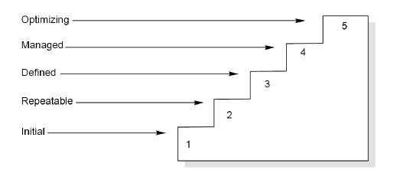

Slide 29
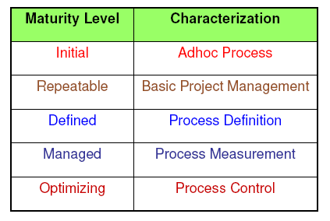
The five levels of CMM

Slide 30
Level 1: Initial
The software process is characterized as ad hoc, and occasionally even chaotic.
Few processes are defined, and success depends on individual effort.
Difficulty in making commitments that the staff can meet with an orderly process.
Products developed are often over budget and schedule.
Wide variations in cost, schedule, functionality and quality targets.
Capability is a characteristic of the individuals, not of the organization.

Slide 31
Level 2: Repeatable
Basic process management processes are established to track cost, schedule, and functionality.
The necessary process discipline is in place to repeat earlier successes on projects with similar applications.
Realistic project commitments based on results observed on previous projects.
Software project standards are defined and faithfully followed.
Processes may differ between projects.
Process is disciplined & earlier successes can be repeated.

Slide 32
Level 3: Defined
The software process for both management and engineering activities is documented, standardized, and integrated into a standard software process for the organization.
All projects use an approved, tailored version of the organization’s standard software process for developing an maintaining software.

Slide 33
Level 4: Managed
Detailed measures of the software process and product quality are collected.
Both the software process and products are quantitatively understood and controlled.
Narrowing the variation in process performance to fall within acceptable quantitative bounds.
When known limits are exceeded, corrective action can be taken.
Quantifiable and predictable.

Slide 34
Level 5: Optimizing
Continuous process improvement is enabled by quantitative feedback from the process and from piloting innovative ideas and technologies.
Goal is to prevent the occurrence of defects
Analysis defects
Data on process effectiveness used for cost benefit analysis of new technologies and proposed process changes

Slide 35
Internal Structure to Maturity Levels
Except for level 1, each level is decomposed into key process areas (KPA).
Each KPA identifies a cluster of related activities that, when performed collectively, achieve a set of goals considered important for enhancing software capability.

Slide 36
Key Process Areas The 6 key process areas at level 2 focus on the software project’s concerns related to establishing basic project management controls, as summarized below:
Requirements management (RM)
Software project planning (PP)
Establish a common relationship between the customer requirements and the developers in order to understand the requirements of the project.
Establish reasonable plans for performing the s/w engg and for managing the s/w project.

Slide 37
3. Software Project Tracking and Oversight (PT)
4. Software Subcontract Management (SM)
5. Software Quality Assurance (QA)
Establish adequate visibility into actual progress so that management can take effective actions when the s/w project’s performance deviates significantly from the s/w plans.
Select qualified s/w subcontractors and manage them effectively.
Provide management with appropriate visibility into the process being used by the software projects and of the products being built.

Slide 38
6. Software Configuration Management (CM)
Establish and maintain the integrity of the products of the s/w project throughout the project’s s/w life cycle.

Slide 39
The 7 key process areas at level 3 address both project and organizational issues, as summarized below:
Organization Process Focus (PF)
Organization Process Definition (PD)
Establish organizational responsibility for software process activities that improve the organization’s overall software process capability.
Develop and maintain a usable set of software process assets that improve process performance across the projects and provide a basis for cumulative, long-term benefits to the organization.

Slide 40
3. Training Program (TP)
4. Integrated Software Management (IM)
Develop skills and knowledge of individuals so that they can perform their roles effectively and efficiently.
Integrate the s/w engineering and management activities into a coherent defined s/w process that is tailored from the organization’s standard s/w process and related process assets.

Slide 41
5. Software Product Engineering (PE)
6. Intergroup Coordination (IC)
7. Peer Reviews (PR)
Consistently perform a well defined engg process that integrates all the s/w engg activities to produce correct, consistent s/w products effectively and efficiently.
Establish a means for the s/w engg group to participate actively with the other engg groups so the project is better able to satisfy the customer’s needs effectively and efficiently.
Remove defects from the s/w work products early and efficiently.

Slide 42
The 2 key process areas at level 4 focus on establishing a quantitative understanding of both the software process and the software work products being built, as summarized below:
1. Quantitative Process Management (QP)
2. Software Quality Management (QM)
Control the process performance of the s/w project quantitatively.
Develop a quantitative understanding of the quality of the project’s software products and achieve specific quality goals.

Slide 43
The 3 key process areas at level 5 cover the issues that both the organization and the projects must address to implement continuous and measurable software process improvement, as summarized below:
Defect Prevention (DP)
Technology Change Management (TM)
Process Change Management (PC)
Identify the causes of defects and prevent them from recurring.
Identify beneficial new technologies (i.e., tools , methods and processes ) and transfer them into the organization in an orderly manner.
Continually improve the s/w processes used in the organization with the intent of improving s/w quality, increasing productivity and decreasing the cycle time for product development.

Slide 44
ISO 9000
The SEI capability maturity model initiative is an attempt to improve software quality by improving the process by which software is developed.
ISO-9000 series of standards is a set of document dealing with quality systems that can be used for quality assurance purposes.

Slide 45
ISO-9000 series is not just software standard. It is a series of five related standards that are applicable to a wide variety of industrial activities, including design/ development, production, installation, and servicing.
Within the ISO 9000 Series, standard ISO 9001 for quality system is the standard that is most applicable to software development.

Slide 46
ISO 9000 OBJECTIVES
It defines quality system standards to meet five objectives
Achieve, maintain and seek to continuously improve product quality [including services] in relationship to requirements
Improve the quality of operations
Provide confidence to internal management
Provide confidence to customers
Provide confidence that quality system requirements are fulfilled

Slide 47
Contrasting ISO 9001 and the CMM
There is a strong correlation between ISO 9001 and the CMM, although some issues in ISO 9001 are not covered in the CMM, and some issues in the CMM are not addressed in ISO 9001.
The biggest difference, however, between these two documents is the emphasis of the CMM on continuous process improvement.
The biggest similarity is that for both the CMM and ISO 9001, the bottom line is “Say what you do; do what you say”.

